Slide 1
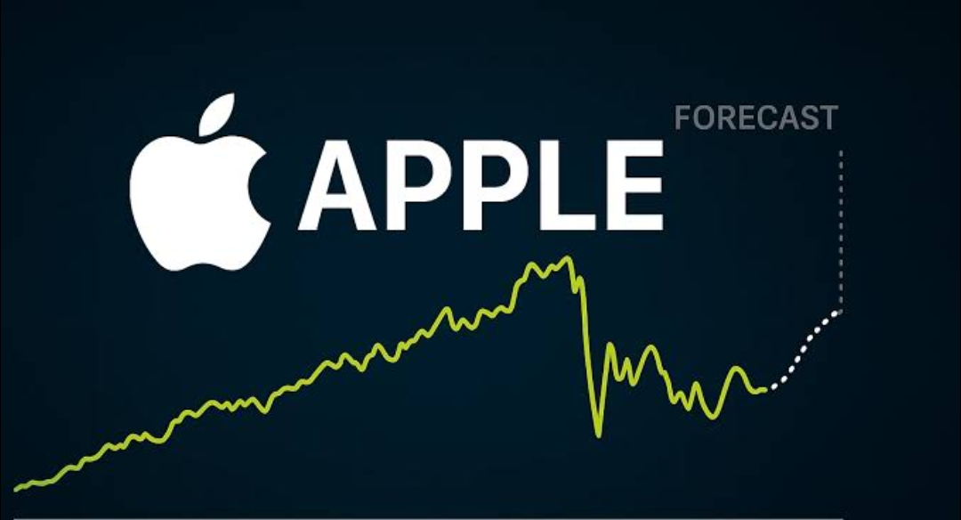
STOCK MARKET ANALYSIS
PRESENTED BY :
CHANNA REDDY S
VELKURU SAI KIRAN
AKASH GOUD
TUSHAR MISHRA
SABARI MANI S
BETHALA SRIKANTH
RUDRA VAISHNAVI
DEEPESH VERMA
Notes:
PRES

Slide 2
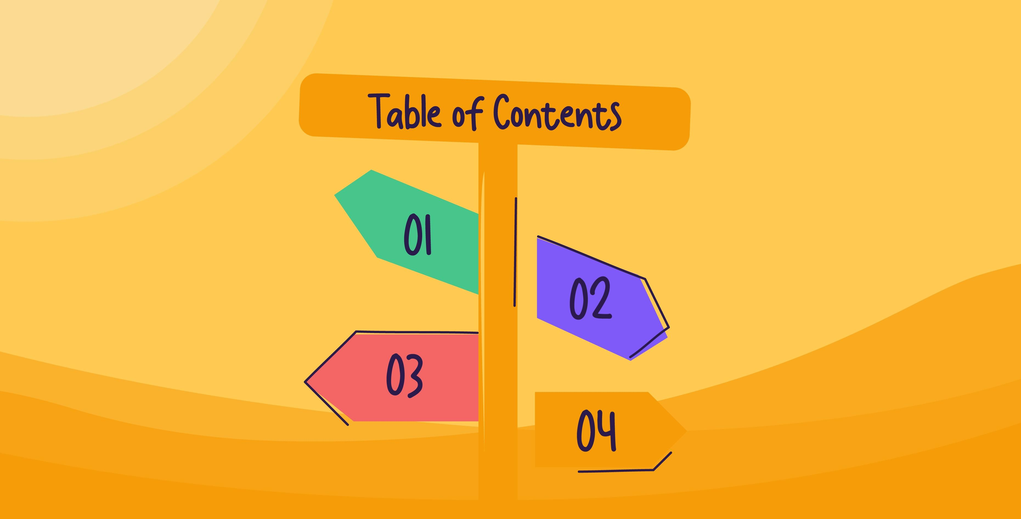

BUSINESS OBJECTIVES
DATA PREPROCESSING
EDA
MODEL BUILDING
MODEL EVALUATION
DEPLOYMENT
CHALLENGES

Slide 3


1.
To develop and apply short-term forecasting models for Apple Inc. (AAPL) stock in order to generate actionable insights and optimize trading strategies over the next 30 days, with the goal of maximizing returns and managing risk

Slide 4
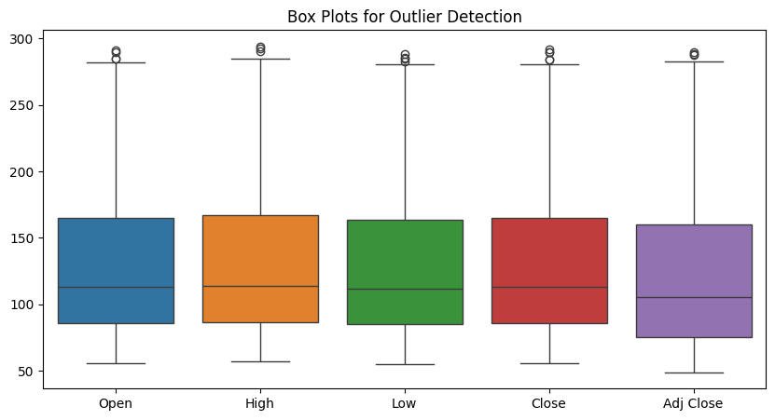
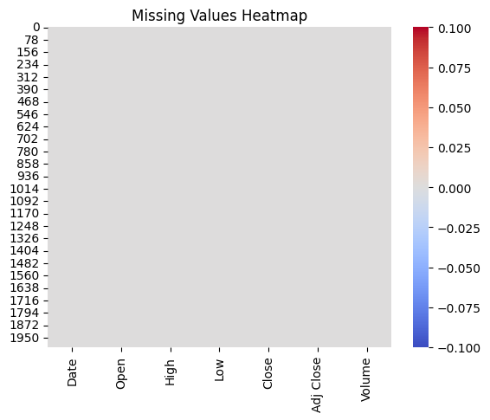
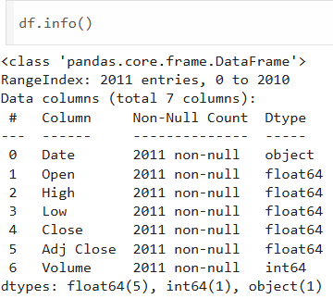
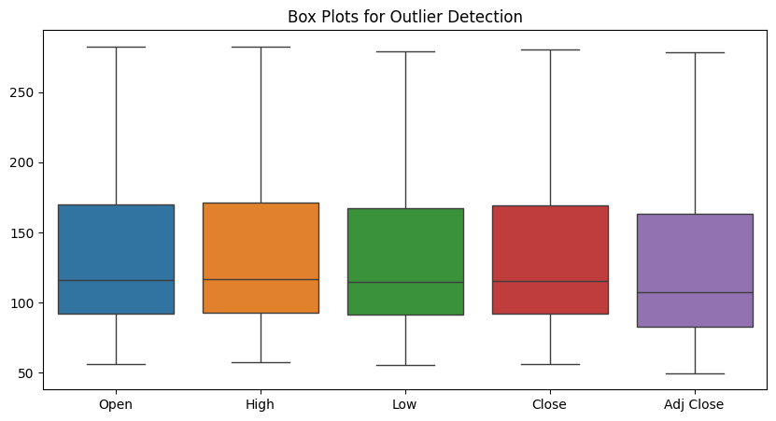
2. Data Preprocessing
- THE DATASET CONTAINS 2011 ROWS AND 7 COLUMNS. - ALL FEATURES ARE NUMERIC - NO MISSING DATA FOUND. THE DATASET IS CLEAN AND READY FOR ANALYSIS.

Slide 5
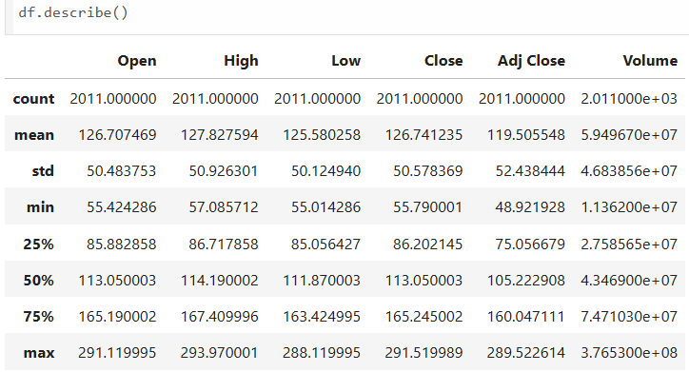
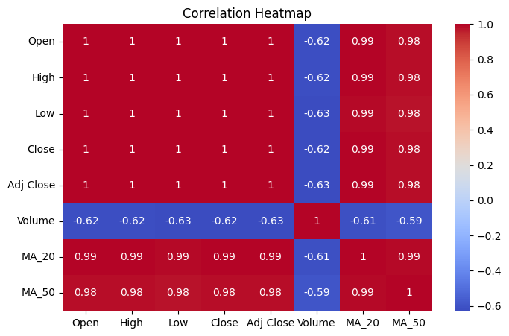
Helped understand the range and central tendency of features like Low, high, close and open.
3. Exploratory Data Analysis
1. STATISTICAL SUMMARY
2. CORRELATION MATRIX
high correlation detected.

Slide 6
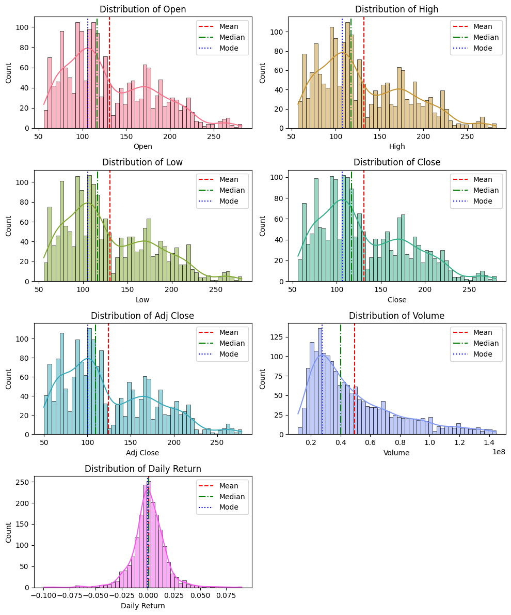
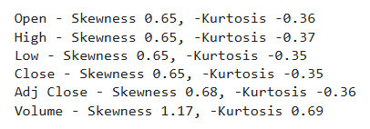
3. UNIVARIATE ANALYSIS
Most of the price-related distributions (Open, High, Low, Close, Adj Close) show positive (right) skew, where mean > median > mode.
This implies that there are occasional very high prices, pulling the mean to the right.
The Volume distribution is also right-skewed, suggesting a few days had unusually high trading volumes.

Slide 7
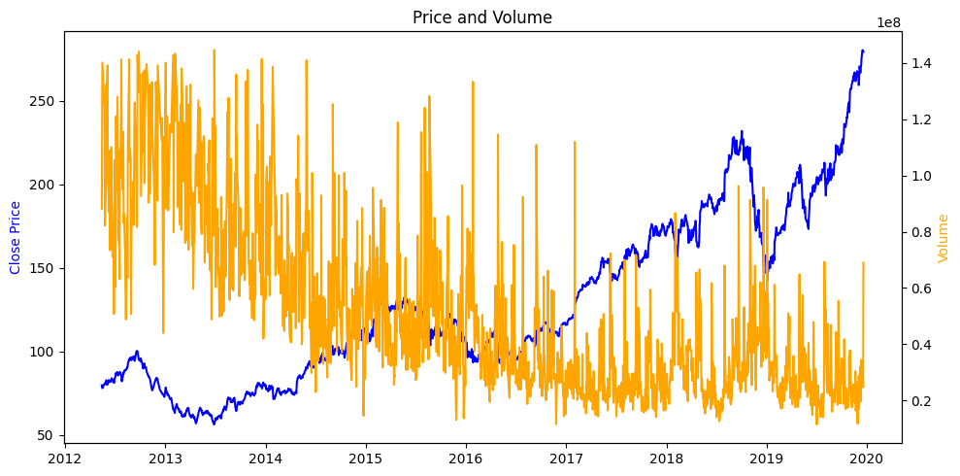
- Strong Uptrend in Price Despite Volume Decline
The blue line (Close Price) shows a consistent and strong upward trend from 2012 to 2020, especially after 2016.
Meanwhile, orange spikes (Volume) show a declining pattern over time.
This suggests that price appreciation is not always volume-driven, indicating fewer trades but possibly by larger investors or more confidence in the stock.

Slide 8
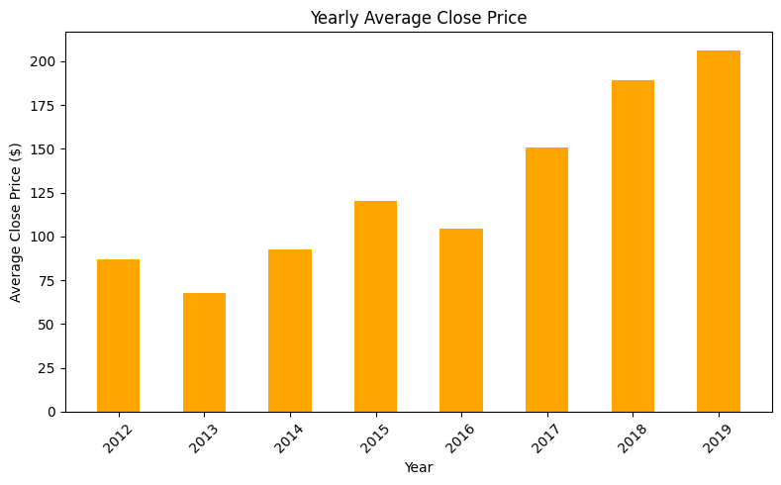
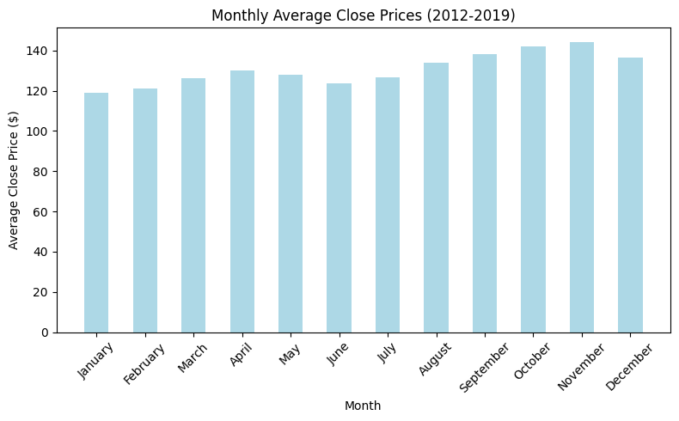
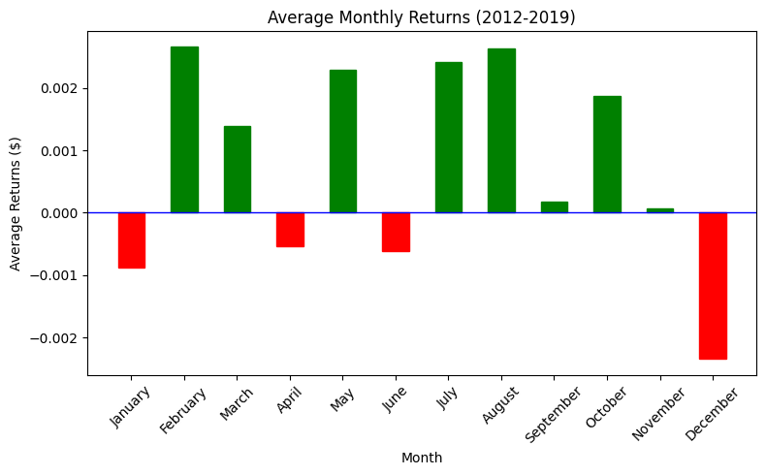
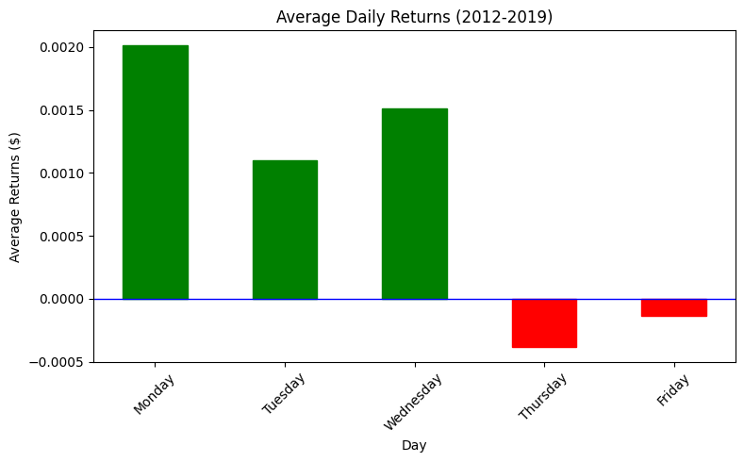
Highest Avg. Close price is seen in 2019
and lowest in 2013.
Highest Avg. Close price is seen in Nov
and lowest in Jan.
Highest Avg. Monthly return is seen in Feb
and lowest in Dec.
Highest Avg. Daily return is seen in Monday
and lowest in Thursday.

Slide 9
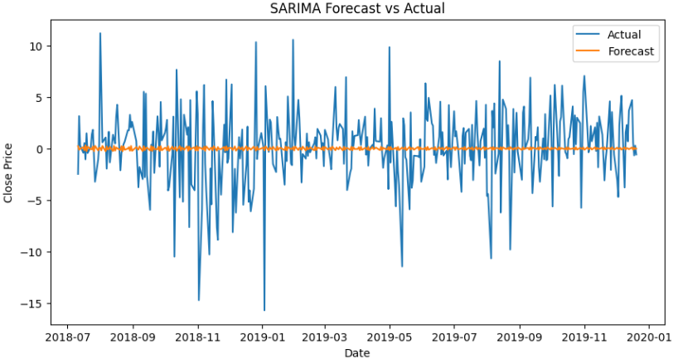


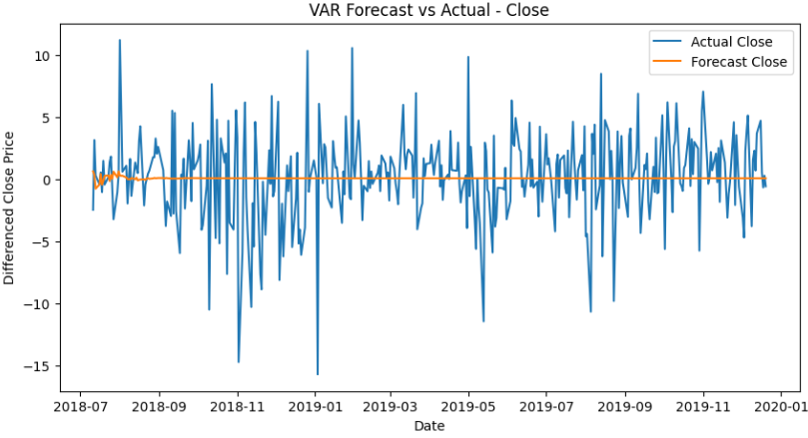
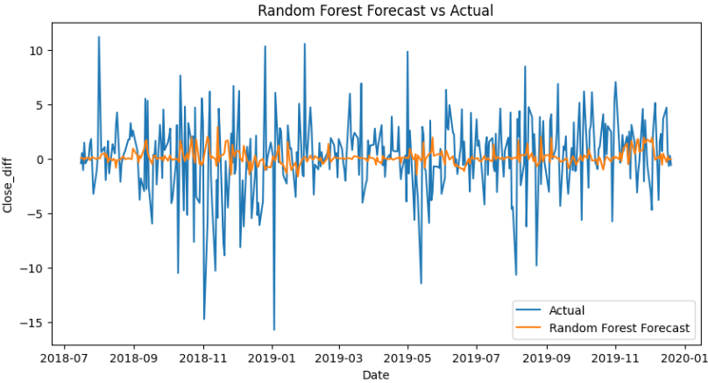
4. Model Building
The Models Forecasting the data in the similar alignment to Actual Close Prices.

Slide 10
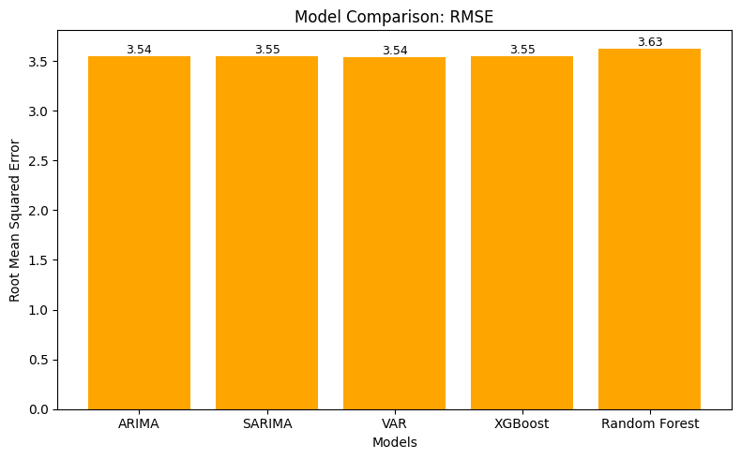
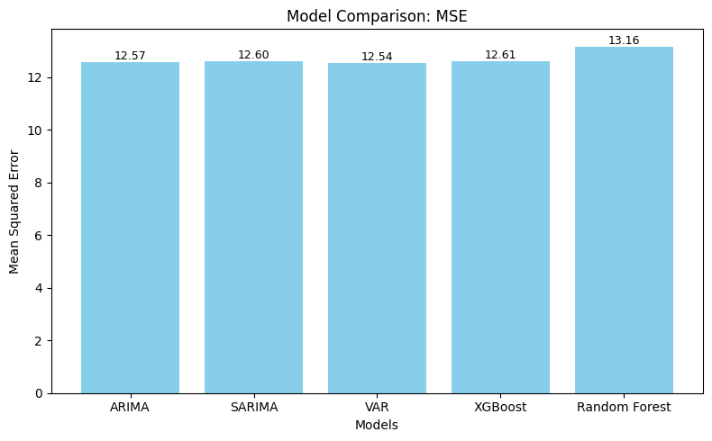
5. Model Evaluation
Model building using different types of models and comparing the models with each other to conclude the better model.
ARIMA, SARIMA, and VAR models all achieved the lowest RMSE (≈ 3.54),

Slide 11
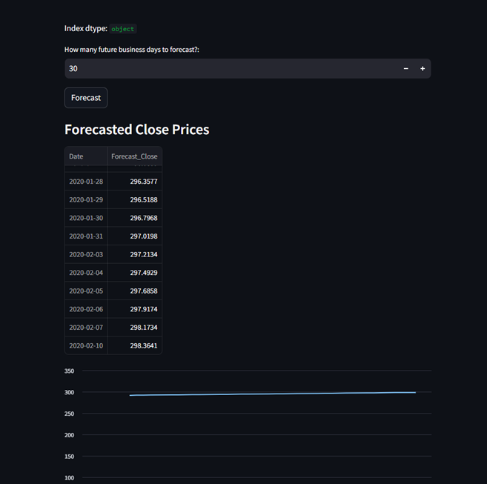
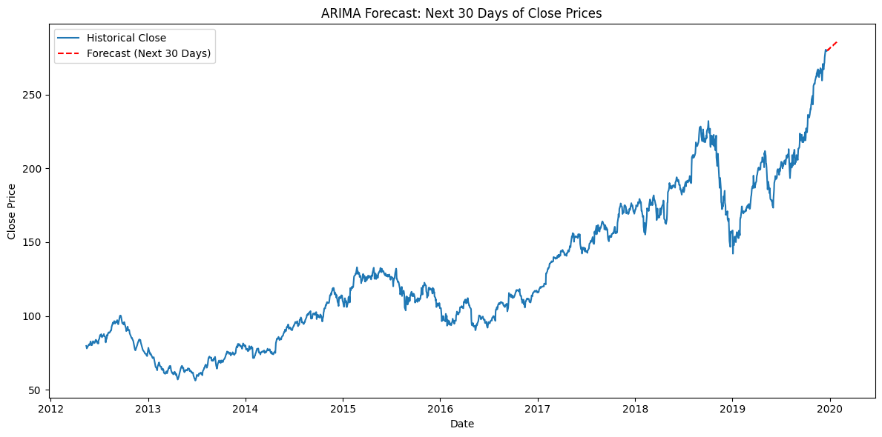
6. Deployment
KEY POINTS
We can adjust in the deployment slide for the prediction for required number of days.
It gives the trend and the predicted values through using the forecasting models.

Slide 12

7. CHALLENGES
DATA PREPROCESSING AND CLEANING
The Volume columns showed consistent outliers, even after IQR treatment, may contain the real values in volatile market.
MODEL SELECTION AND EVALUATION
Choosing the best model among multiple candidates and evaluating their performance.
DEPLOYMENT
Transitioning a model from a development environment to a production environment where it can be used for prediction.

Slide 13


